Slide 1
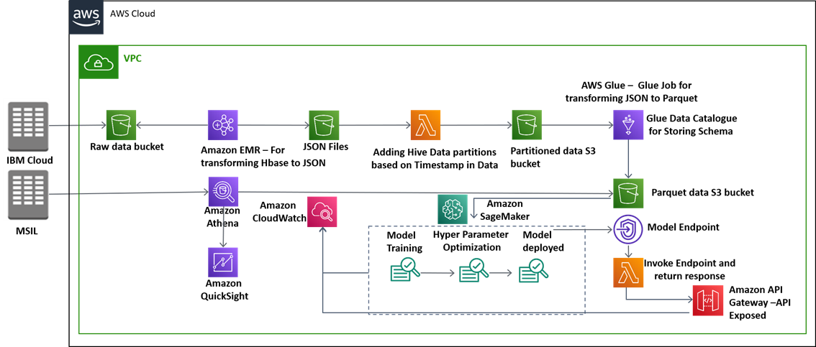

Case Study – Maruti Vehicle Demand Forecasting
The client wanted to do demand forecasting of selected largest selling models leading to right production planning for these models as a result savings in inventory costs by their customer demand.
Challenges
Find the sales of the vehicles for the upcoming months.
Various leading economic indicators taken into account.
Data consolidation at different granularity levels – daily, monthly etc.
Past 3 years data for forecasting.
Solution
Final Tables contains detailed data about the invoice, we have scrapped economic indicators, competition and holidays data from Internet.
Data analyzed using multiple techniques, like exploratory data analysis, feature selection, dimensionality reduction, regression analysis, hyperparameter tuning. To match demand 37+ models were created
Benefits
93%
Accuracy of Forecasting Model
Reduced model training and deployment costs

Slide 2
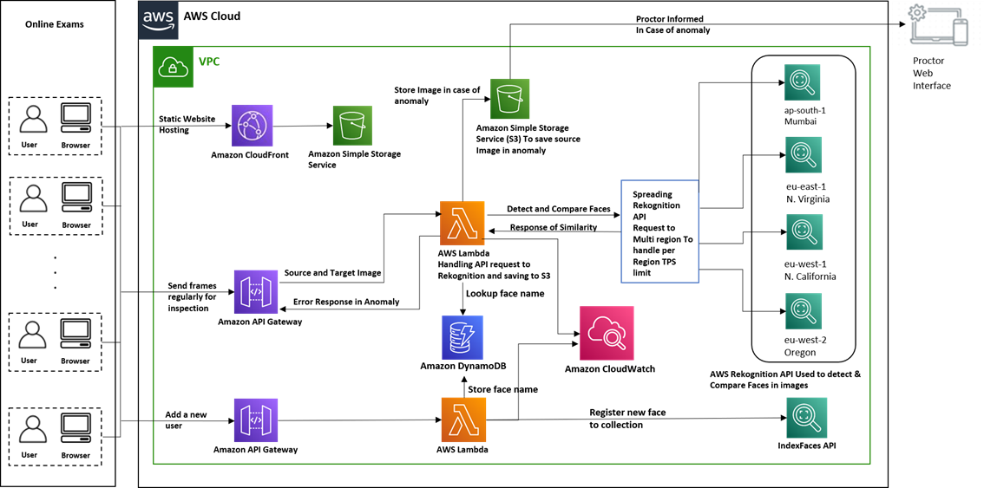
Case Study – Ginger Webs Solutions (Online Proctoring)
The client conducts online exams via web & mobile platforms, and to do effective online proctoring, AI based proctoring solution is built using face recognition. Load Balancing of about 6k examinees is also managed.
Challenges
Multiple AWS services APIs are directly called in web and mobile app, which is problematic due to unreliable internet.
Managing multiple Service calls from the browser
AWS Rekognition TPS limit implementation
API retry mechanism on failure
Solution
Developed one JSON Restful API using AWS API Gateway
Multiple AWS API calls are clubbed using AWS Lambda
AWS Rekognition detect, compare faces and upload on S3
AWS Lambda distributes Rekognition requests in multiple AWS regions to handle TPS limit
Internal API calls has retry mechanism and exception handling
Benefits
21%
Compute costs
40%
Manual processing effort

Slide 3
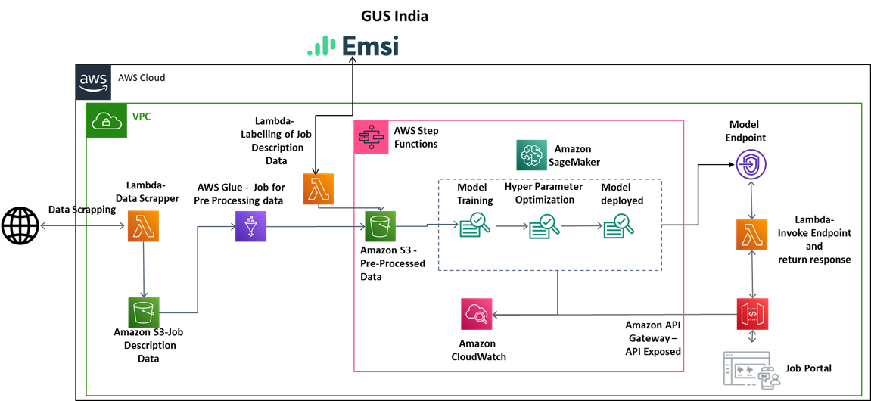
Case Study – GUS Education
The client has a Job Portal which recruiters use to upload job notifications and candidates use the job portal to create their profile with their latest skills. They wanted to map the right job description to the candidate based on their skills to match jobs with suitable candidates.
Challenges
Performance issues (Portal Slowness with increasing users)
Mapping the right job description to the right candidate based on their skills
Notifying the suitable jobs timely
Ensure reduced cycle time to fill the vacancy
Solution
Data collection is done by scheduling AWS Lambda
Pre-processing of job descriptions data
Labelling of Job descriptions data to skills using EMSI API
Pre-Processing for model training
ML model trained (NER) using Blazing Text and BERT
Hyper parameters tuned iteratively to optimize the model
Deployed the ML model using Flask API
Benefits
60%
Human effort
90%
Reduced training costs
80%
Extraction accuracy

Slide 4
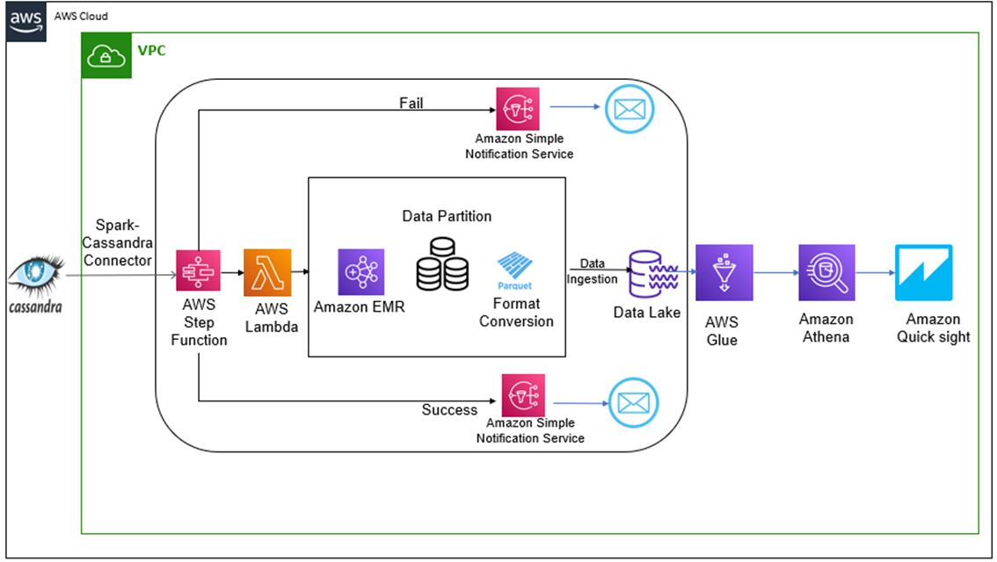
Case Study – SAMRAX
The client uses trucks for the transportation of finished vehicles. These trucks have various sensors whose data is stored in Cassandra Database. Cassandra is efficient in write operations, but the OLAP requirements could not be met.
Challenges
Scaling the solution
The increasing variety of data
Long term storage, governance and query strategy
Easy and efficient reporting for adhoc analysis.
Cost-effective, should justify the ROI from the data analyzed.
Solution
Spark Cassandra Connector from Datastax used to access data form Cassandra DB using EMR on AWS
Lambda invokes EMR Cluster to trigger data ingestion job
Spark job written for data cleaning, transformation and conversion, data partitioned on data timestamp
Lake Formation used to set up and secure Data, Athena used for queries and Quicksight for visualization.
Benefits
90%
Improved analysis and query time
15%
Improved on-time shipment
20%
Cost saving

Slide 5
Case Study – Maruti Vehicle Component Health Prediction
Challenges
Dimensionality Reduction & selection of hyperparameters
Cost for data storage and errors while transferring data from different cloud provider to AWS.
Efficient Distribution of data to executors on worker nodes to process large volumes of data.
20 TB one-time transfer and hereafter 2 TB daily.
The client wanted to build a Health Monitoring System for various components of car manufactured. This included ingestion of data from different cloud providers to AWS cloud and performing preprocessing and analytics using ML models and storing data in S3.
Solution
Data Ingested from IBM cloud to AWS Cloud
Transformation and partitioning of csv and json data into parquet format
Running Amazon EMR on incremental data daily, various analysis performed including PCA and feature engineering.
Component health predicted using modeling techniques like Linear Learner, XGBoost which then undergo hyperparameter optimization.
Benefits
18%
Reduced repair costs
30%
Reduced number of callbacks
Increased trust in brand and customer loyalty response time

Slide 6
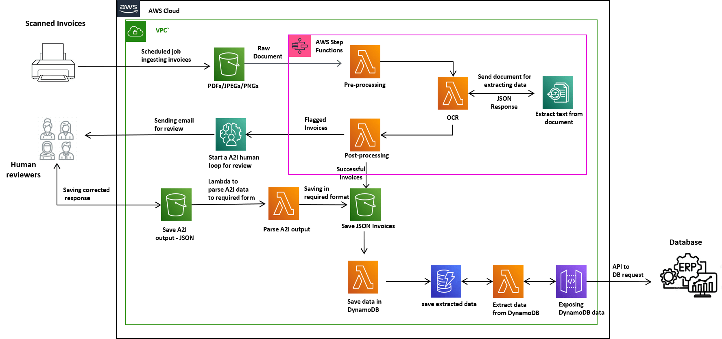
Case Study – MATE
Client wanted to do the digitization of the invoices received from different vendors, primarily focused on the Header, Footer and Item Level Information. We received invoices in pdf format, had to extract the relevant information and store it to the database.
Challenges
Reduce the effect of noise for the processing of document.
Extracting the Key-pair values from raw file.
Matching different types of amount values in invoice
Parsing of Item level Information and converting to tabular format in JSON and ensuring every column is extracted.
Solution
Pre-Processed the raw pdf files to reduce the effect of noise including signature, seal and handwritten marks in pdf.
Did Post-Processing on the response to extract the relevant information like Header, Footer and Item Level Information in desired format like Json
Uploaded the final Json File to the S3 & saved into database also.
Benefits
40%
Human effort
5%
Increased information extraction
Reduced cycle time

Slide 7
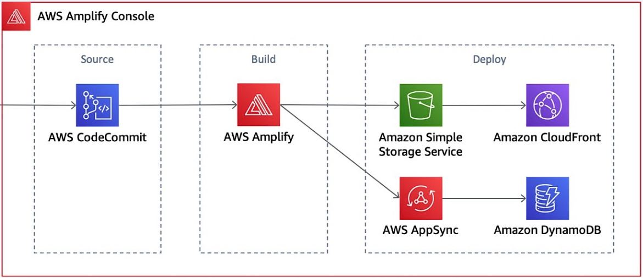


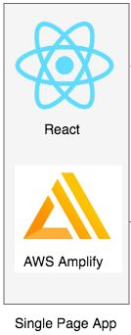




Case Study – Covid Assessment Bot
Client wanted a chatbot consisting of an interactive interface for voice and text-based interactions around COVID questionnaire. It consists of a genie which interacts as a chatbot with voice or text-based interactions. It leverages multiple features of AI such a voice, NLP and decision making.
Challenges
Correct questioning of COVID related symptoms
Scalable solution for multiple concurrent clients
Data security of health-related data.
Multi browser compatibility
Hosted on HTTPS secure link to facilitate voice interaction.
Solution
User interaction with the Gennie bot
Voice and text-based input options
Chatbot gives voice and text-based responses
Real Time Responses based on Conversation
A framework-independent, decoupled frontend architecture using AWS Amplify
Visit the following link to access the bot: https://master.dcjrsebf77vbs.amplifyapp.com/Chat

